Slide 1

Analyzing Educational Dropout: Data & Modeling Approach
This analysis investigates the factors influencing educational dropout rates, focusing on socioeconomic and structural variables. We utilized multiple datasets UDISE+ and NFHS-5 data to inform targeted policy interventions.
to build a comprehensive model, ensuring the findings are grounded in robust data from various sources.
Objective
Identify key predictors of student dropout and formulate targeted policy recommendations.
Scope
Focus on enrollment, district profiles, and socioeconomic proxies (IHDS income data).
Notes:
1

Slide 2



Data Analysis Prompt-2
Do dropout and retention patterns differ between urban and rural districts and when disaggregated by gender and caste?
Notes:
1.7.2013
1
‹#›

Slide 3

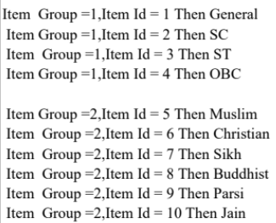
Datasets and Data Preparation Steps
The analysis integrated enrollment data, district profiles, and socioeconomic indicators, requiring careful mapping and aggregation to create the final analytical dataset.
Datasets Used
Key Processing Steps
enr1.csv, enr2.csv: Enrollment data (2023–24, 2024–25)
01
02
prof1.csv, prof2.csv: District profiles (state, rural/urban info)
Code Mapping
Data Aggregation
IHDS (2004–05): Incomes adjusted for 2024–25 as socioeconomic proxy.
Mapped rural/urban codes and caste from item_group & item_id.
Aggregated enrollment by caste, gender, and district (rural/urban).
03
Dropout Calculation
Calculated dropout rate per grade
(negative values clipped to 0).
Notes:
3

Slide 4





Modeling Dropout Rates with Random Forest
A Random Forest model was employed to determine the most influential factors contributing to student dropout, providing a clear hierarchy of predictors.
Parental Education
Caste-Income Proxy
Female parental education emerged as the single most important predictor which can be extrapolated to education of parents
Socioeconomic status, proxied by the IHDS caste-income link, was a major factor.
Infrastructure & Staff
Teacher availability and school infrastructure also significantly influenced dropout rates.
Notes:
4

Slide 5




Indicator Rationale and Core Assumptions
The model's indicators were selected to capture the multi-dimensional nature of dropout, reflecting structural, economic, and cultural influences.
Rural/Urban
Gender
Proxies for differences in access to schools and quality of infrastructure.
Reflects socio-economic and cultural influences on educational priorities.
Caste & Income
Parental Education
Caste acts as a proxy for economic disadvantage, linked to IHDS income data.
Integrated from NFHS dataset to assess its direct impact on retention.
Critical Assumption: Dropout rates are calculated only for enrolled students. This means the figures may underestimate the true number of out-of-school children, especially where initial enrollment is low.
Notes:
5

Slide 6

Key Insight 1: The Rural-Urban Divide
A clear disparity exists between rural and urban districts, though both face significant challenges in retaining students.
Rural Districts
Show significantly higher dropout rates, primarily due to limited infrastructure and teacher shortages.
Urban Districts
While having better resources, urban areas still experience high dropout rates driven by competitive pressure and other complex factors.
Addressing structural deficits in rural areas is crucial, but urban strategies must focus on mitigating competitive and socioeconomic pressures.
Notes:
6

Slide 7
Key Insight 2: Caste and Income Link to Dropout
Socioeconomic disadvantage, proxied by caste and income, strongly correlates with higher dropout rates among marginalized groups.
Higher Dropout
Prominent Reason
SC/ST/OBC/Muslim students show higher dropout rates compared to general or upper caste students.
The primary driver is the lower average income of these groups, indicating economic pressure is a major factor.
Adjusted IHDS Income Estimates (Approx. 2024–25)
Forward Caste Hindu
Rs. 72,717
Rs. 3,49,041
OBC
Rs. 42,331
Rs. 2,03,150
SC
Rs. 34,128
Rs. 1,63,814
ST
Rs. 32,345
Rs. 1,55,256
Muslim
Rs. 44,158
Rs. 2,11,958
Other Religions
Rs. 1,01,536
Rs. 4,87,370
Notes:
7

Slide 8

Policy Recommendation 1: Conditional Incentive Scheme
To combat economic pressures driving dropout, especially in higher grades, a targeted financial incentive program is recommended for vulnerable families.
Target Group
1
Families with uneducated parents and income below a specified threshold.
Incentive Structure
2
Offer financial rewards for families whose children successfully complete each class from Grade 8 through 12.
Duration & Impact
3
Implement for 20 years to ensure the next generation is educated, creating a positive intergenerational cycle.
Notes:
9

Slide 9



Policy Recommendation 2: "Earn While You Learn" Program
Integrating vocational training and paid work into the schooling process can directly address the economic necessity that forces many students to leave school prematurely.
Integration
Economic Relief
Examples
Integrate paid part-time work or vocational internships directly within the school curriculum.
Helps reduce dropouts by providing side income, mitigating economic pressure, especially in rural areas.
Tutoring juniors, assisting with small government chores, or working in local shops/restaurants.
This approach ensures students gain valuable skills while remaining in the educational system.
Notes:
10

Slide 10


Conclusion: A Multi-Dimensional Approach to Retention
Dropout and retention patterns are complex, driven by the interplay of economic, structural, and social factors. Effective policy requires a targeted, multi-pronged strategy.
Social
Social‑Economic
Social‑Structural
Complex, Interlinked Causes
Economic‑Structural
Economic
Structural
Targeted policies combining financial incentives, vocational integration, and rural infrastructure development can significantly reduce dropouts, particularly in the critical grades 8–12.
Notes:
11

Slide 11

Data Analysis Prompt-3
A comprehensive assessment of school retention, teacher availability, and sanitation infrastructure at both school and district levels is crucial for informing evidence-based policy decisions in education.
Notes:
12

Slide 12
Data Sources and Key Metrics
Data Used (UDISE 2023–25)
Processing & Computed Metrics
Enrolment data
Data was cleaned, merged, and used to compute essential metrics:
Teacher data (total & trained)
Facility and school profile data
Retention Rate
Key fields: total enrolment, functional toilets, school type, management, rural/urban, district.
Pupil–Teacher Ratio (PTR)
Functional Toilet Ratio
Year-on-Year Changes
Missing or extreme values (e.g., PTR > 200) were handled to ensure data integrity.
Notes:
13

Slide 13
Rationale Behind Indicator Selection
The chosen indicators directly measure key outcomes and inputs affecting the quality and accessibility of education.
Retention Rate
Pupil–Teacher Ratio (PTR)
Measures student continuation across grades—a key outcome metric for evaluating education quality.
Captures teacher availability and workload; directly affects teaching quality and student engagement.
Functional Toilets (%)
Average Teachers per School
Represents basic sanitation and hygiene infrastructure; crucial for student health and especially girls’ attendance.
Reflects human-resource capacity and stability of school operations.
Notes:
14

Slide 14


Underlying Assumptions for Policy Modeling
Our analysis rests on two core assumptions regarding the relationship between infrastructure, human resources, and student outcomes.
Influence on Retention
Hygiene Proxy
We assume that better PTR and facilities promote student attendance and reduce dropouts, meaning teacher availability and infrastructure influence retention.
Functional toilet data is used as a hygiene proxy, assuming that the availability of functional toilets corresponds to actual usability and positively impacts attendance, particularly for girls.
Notes:
15

Slide 15
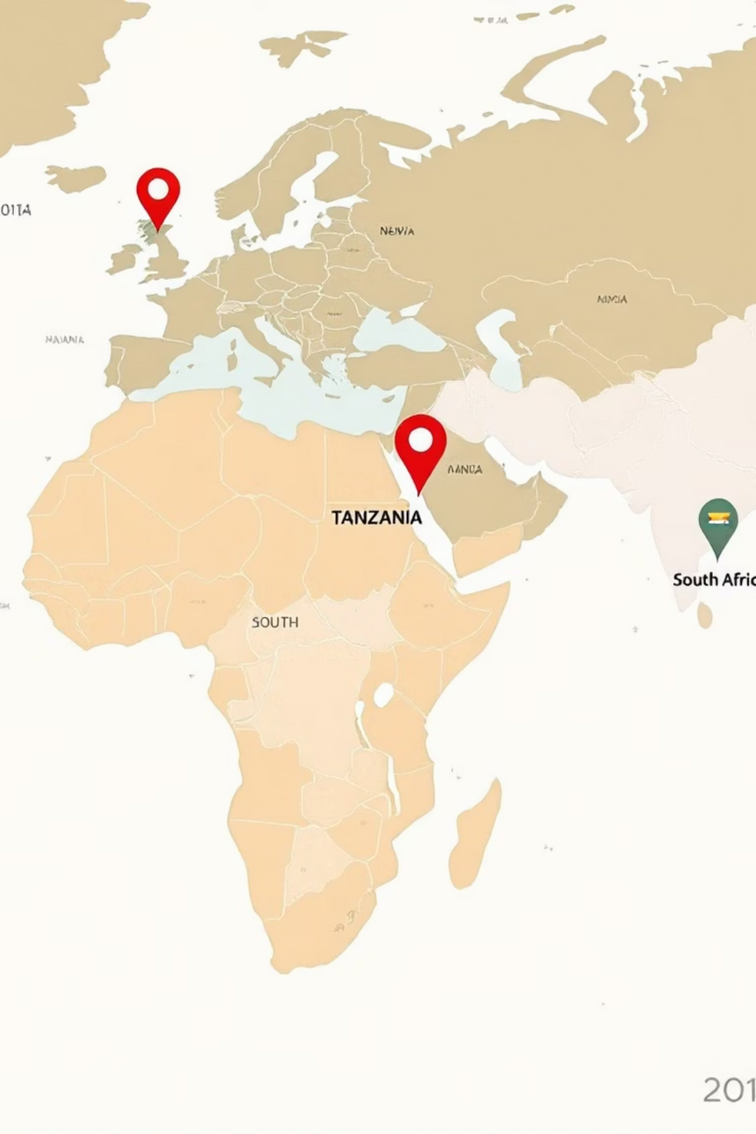
Case Study: International Sanitation Policies
Reviewing international practices provides valuable insights for adapting effective policies on school sanitation and Menstrual Hygiene Management (MHM).
Notes:
16

Slide 16

Tanzania: School Sanitation & MHM Program
Key Interventions
Impact
Improved school sanitation blocks.
The program successfully increased adolescent girls’ retention and participation in school.
Separate, lockable latrines for girls and boys.
Disposal bins for MHM products.
Hand-washing stations.
Policy Elements to Adapt: Mandate separate, lockable girls’ toilets; ensure disposal facilities; install hand-washing stations as standard, especially in rural schools.
Notes:
17

Slide 17

South Africa: Equal Education Sanitation Campaigns
Focus on Community Advocacy
In the Gauteng Region, students and community groups actively advocated for better school toilets. This activism highlighted the severe impact of poor sanitation on girls’ attendance and dignity.
The campaigns successfully resulted in the allocation of funds and renovation of
sanitation blocks.
Policy Elements to Adapt: Implement community-led audits of school sanitation
and link community activism directly to policy and funding decisions for
infrastructure upgrades.
Notes:
18

Slide 18
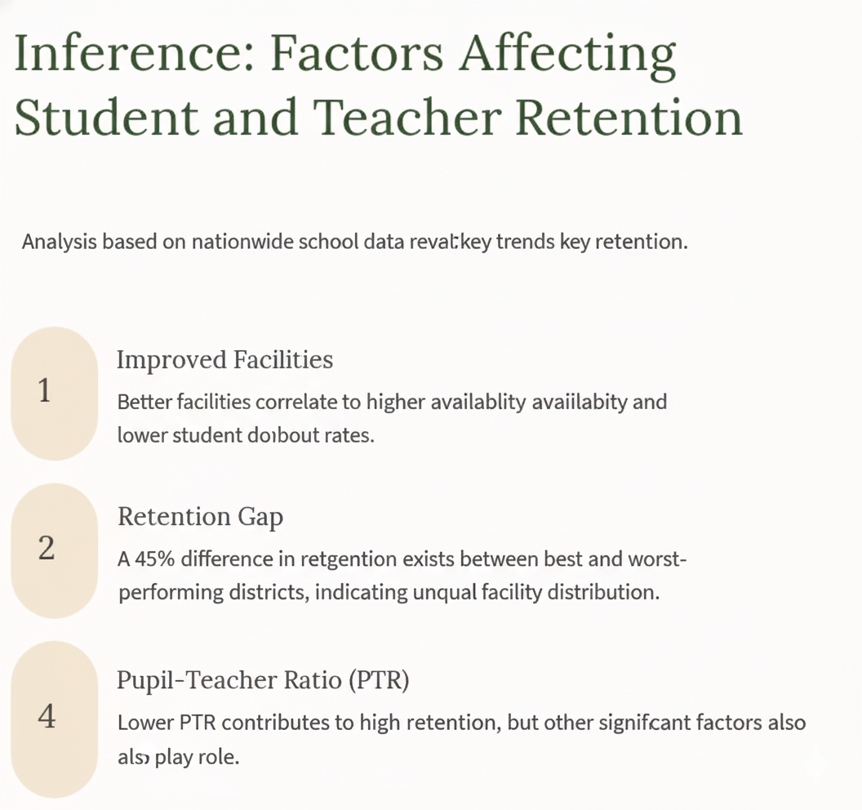


Slide 19
Policy Recommendation: Minimum Infrastructure Standards
Establishing and enforcing clear national standards for school sanitation is the foundation for improving student health and attendance.
Toilet-to-Student Ratios
1
Mandate 1 toilet per 30 girls and 1 toilet per 60 boys nationally.
Special Funds
2
Allocate special funds to upgrade rural or underdeveloped schools.
Comprehensive Upgrades
3
Upgrades must include teacher amenities (staff quarters, restrooms) and digital classrooms.
Notes:
19

Slide 20



Policy Recommendation: Hygiene Promotion & Ambassadors
Beyond infrastructure, promoting a culture of hygiene through student involvement is essential for sustainability.
Awareness Campaigns
Monitor & Report
Ambassadors run hygiene awareness campaigns and educate peers on best practices.
Appoint Ambassadors
Ambassadors monitor toilet cleanliness, ensure supplies, and report maintenance issues promptly.
Appoint volunteer students as Hygiene Ambassadors on a rotating monthly basis.
Incentives for Ambassadors, such as certificates, recognition, or small vouchers, should be provided to encourage participation.
Notes:
20

Slide 21


Incentives for Teachers and Community Support
To ensure the success of infrastructure and hygiene standards, incentives for staff and community engagement are vital.
Performance-Based Bonuses
Offer performance-based bonuses or housing allowances for teachers in schools that consistently meet infrastructure and sanitation standards.
Parent–Teacher Appreciation Fund (PTAF)
Establish a voluntary, transparent, and community-managed system where parents can contribute funds to recognize and support teachers.
Notes:
21

Slide 22
Data Analysis Prompt-6
How do household income, parental education, and employment status relate to student enrolment and dropout rates?
Notes:
1.7.2013
1
‹#›

Slide 23
Datasets Used
Our Modeling Approach
UDISE :
100_prof1.csv – School profiles.
100_enr1.csv – Enrolment data.
100_tch.csv – Teacher information.
100_fac.csv – School infrastructure details.
01
02
03
Dropout Rate Calculation
Educational Indicators
Social Integration
Computed district-wise dropout rates using UDISE enrollment data across two years (Class 8→9, Class 10→11).
Derived key metrics: Pupil-Teacher Ratio, toilet availability, electricity, and library access from school data.
Integrated NFHS indicators including female literacy, early marriage rates, and sanitation access.
04
05
Statistical Analysis
Visualization
Applied Random Forest regression and correlation analysis to identify influential factors.
Developed interactive web-based visualization dashboards using React
Notes:
23

Slide 24






Indicator Categories
Educational Environment
Pupil-Teacher Ratio, school facilities (toilets, library, electricity) reflect learning quality and teacher attention.
Parental Education
Female literacy and women with 10+ years schooling influence children's educational prioritization.
Household Wealth
Access to electricity, sanitation, and safe water indicates economic capacity to support schooling.
Social Factors
Early marriage, teen pregnancy, and family planning awareness directly impact school continuation.
Notes:
1.7.2013
3
‹#›

Slide 25
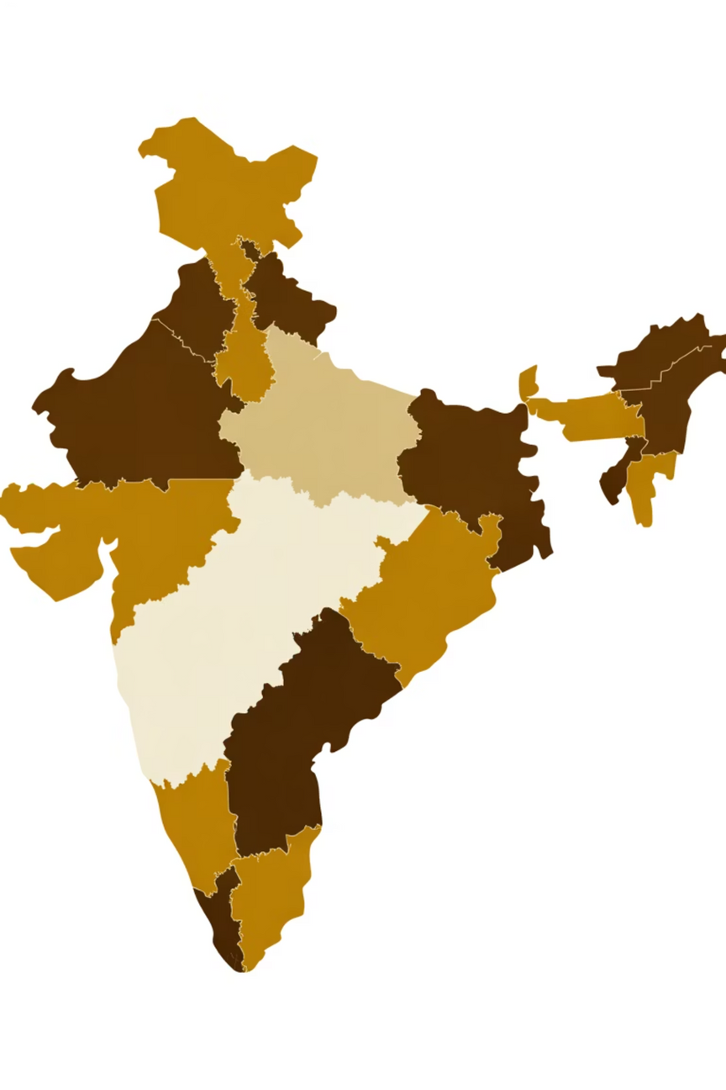
Key Assumption
District-level averages represent broad local conditions influencing school continuation decisions. While individual variation exists, patterns at scale identify where interventions are most needed.
Notes:
1.7.2013
4
‹#›

Slide 26

Top Predictor: Parental Education
The Challenge
Policy Action
Our analysis finds that districts with higher female education levels and stronger school infrastructure — especially electricity, libraries, and adequate teacher availability — record better student retention outcomes.
When women complete over 10 years of schooling, it has a lasting impact, as educated mothers prioritize and sustain their children’s education.
Lower pupil–teacher ratios further enhance classroom attention and reduce dropouts.
However, limited access to electricity and libraries continues to restrict learning continuity.
1.Enhance Women’s Education and Community Awareness: Expand programs promoting girls’ secondary completion and adult women’s education, as higher maternal schooling strongly predicts better student retention.
2.Strengthen School Infrastructure and Staffing: Prioritize teacher recruitment and balanced deployment alongside universal electrification and library access in schools to improve learning environments and sustain enrolment.
Notes:
1.7.2013
5
‹#›

Slide 27





Social Vulnerabilities Impact Girls
Early Marriage
Positive correlation between early marriage rates and dropout across districts.
Teen Pregnancy
Directly interrupts schooling, especially for adolescent girls.
School Exit
Social pressures force permanent departure from education system.
Recommendation: Strengthen adolescent education programs and enforce early marriage prevention campaigns through community outreach.
Notes:
1.7.2013
6
‹#›

Slide 28
Infrastructure Matters
⚡
🚽
💧
Electricity Access
Sanitation Facilities
Safe Water
Districts with better electricity access show lower dropout rates.
Proper toilets, especially for girls, significantly reduce dropout risk.
Access to clean water indicates household stability supporting education.
Better household infrastructure creates conditions where families can prioritize consistent school attendance over immediate survival needs.
Policy Priority: Link education outcomes to rural infrastructure schemes including toilets, electrification, and school repairs.
Notes:
1.7.2013
7
‹#›

Slide 29

Policy Recommendations Summary
1
2
Teacher Recruitment
Girls' Education Protection
Prioritize hiring in high-PTR districts and implement digital teaching support systems.
Strengthen adolescent programs and enforce early marriage prevention through community engagement.
3
4
Infrastructure Investment
Women's Empowerment
Link education outcomes to rural development schemes for toilets, electricity, and school facilities.
Expand adult education programs for mothers to create generational educational impact.
Investing in teacher availability, girls' education awareness, and household infrastructure can significantly reduce dropout rates and improve long-term educational outcomes.
Notes:
1.7.2013
10
‹#›

